Slide 1

Effective Image Reconstruction Using Compressed Sensing
Sahil Patil (24M1087)

Slide 2

Compressive Sensing
1
Sparsity
Exploits signal sparsity in specific domains.
2
Efficiency
Reconstructs signals from fewer measurements.
3
Applications
Useful in medical imaging, autonomous vehicles, surveillance systems.

Slide 3
Flexible Compressed Sensing (FCS)
Adaptive Sensing
Total Variation Minimization
Adjusts sensing matrix to image characteristics.
Preserves edges while reducing Noise
Dictionary Learning
Deep Learning
Dictionary of basis elements allowing sparse representation
Utilizes Deep Neural Networks

Slide 4
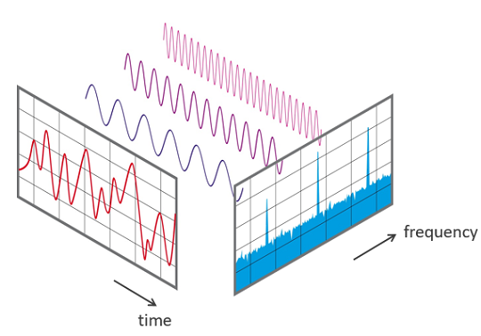
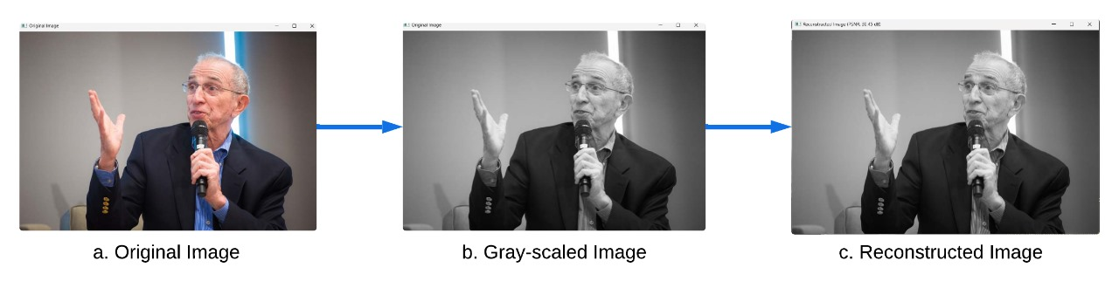
Discrete Fourier Transform (STOne)

Slide 5
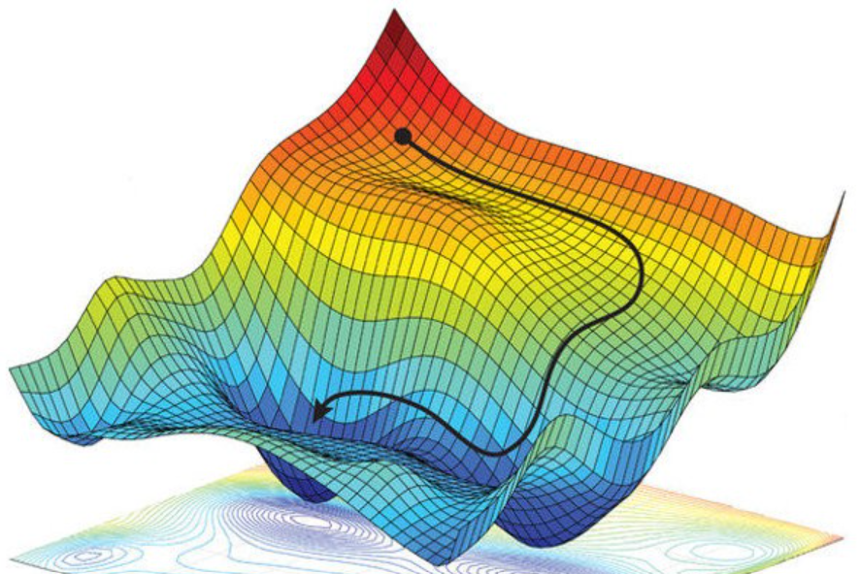
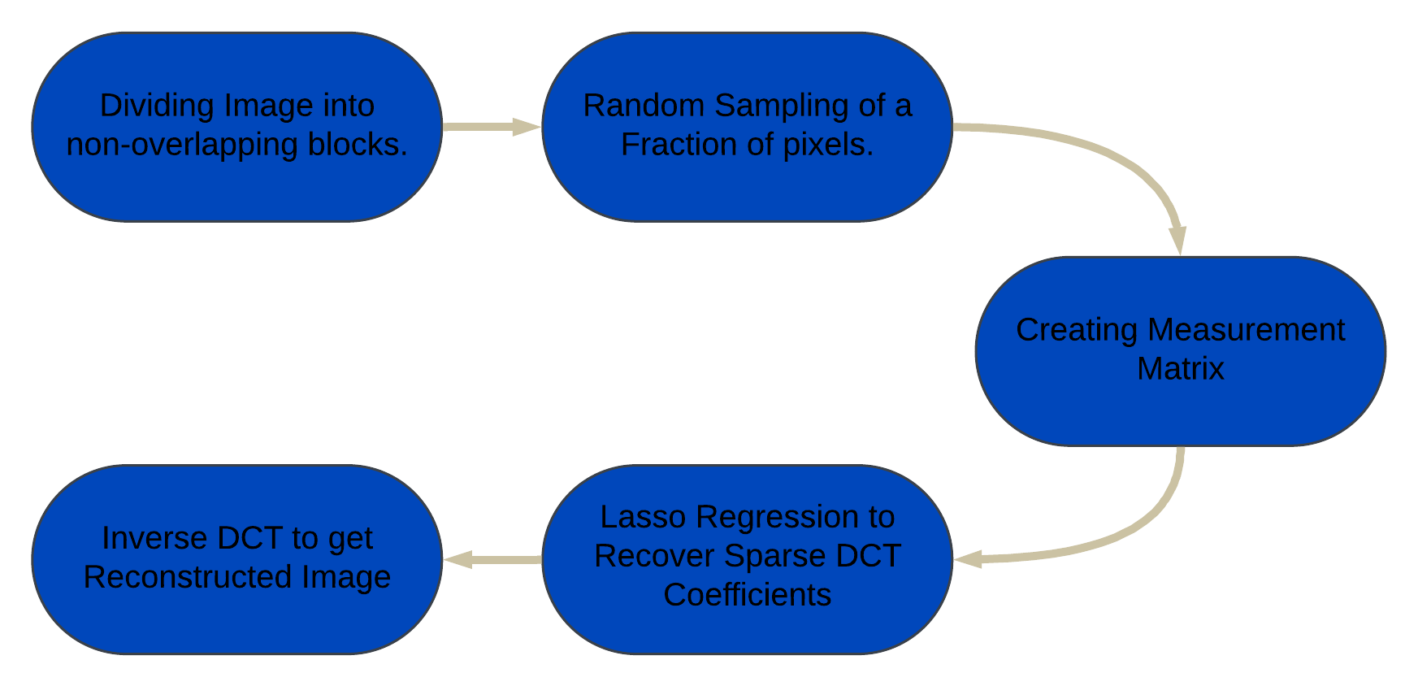
Compressed Sensing with Discrete Cosine Transform

Slide 6

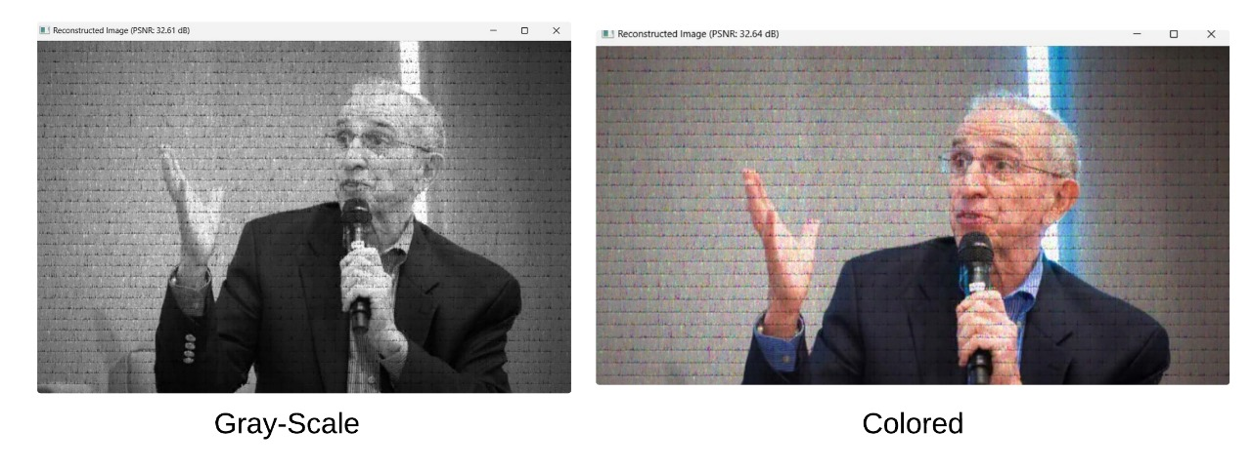
Compressed Sensing Results

Slide 7




Deep Learning Approach
Neural Networks
Adaptability
Resources
Uses CNNs and Residual Networks for reconstruction.
Learns complex relationships between input and output.
Requires substantial computational power and large datasets.

Slide 8

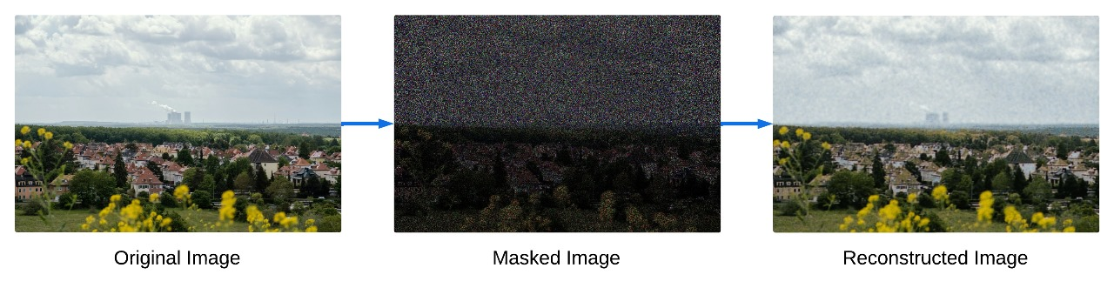
Deep Learning

Slide 9

Implementation Comparison
Method
Domain
Quality
Complexity
FCS Transformation
Frequency
Moderate
Low-Moderate
CS with DCT
Sparse (DCT)
High
Moderate-High
Deep Learning
Learned Features
Very High
High

Slide 10

Conclusion and Future
1
Method Selection
2
Tradeoffs
3
Future
Depends on image characteristics, resources, and objectives.
Balance between quality, complexity, and flexibility.
Ongoing advancements in compressed sensing techniques.

